Slide 1
Equations
&
Inequalities

Slide 2
$$Solving Linear equations$$
$$\& inequalities$$

Slide 3
$$Isolate the variable$$

Slide 4
$$Solving Quadratic$$
Equations & Inequalities

Slide 5
Isolate Zero

Slide 6
$$Solving Polynomail$$
Equations & Inequalities

Slide 7
Isolate Zero

Slide 8
$$Solving Rational$$
Equations & Inequalities

Slide 9
Multiply by the LCD

Slide 10
$$Solving Absolute Value$$
Equations & Inequalities

Slide 11
Isolate the absolute value

Slide 12
$$Solving Absolute Value$$
Equations
$\left|a\right|$ =

Slide 13
a, if a > 0
-a, if a < 0

Slide 14
$$Solving Absolute Value$$
Inequalities
$\left|f(x)\right|$ > c means….

Slide 15
f(x) > c
OR
f(x)< -c

Slide 16
$$Solving Exponential$$
$$Equations$$

Slide 17
Isolate the power

Slide 18
$$Solving Radical$$
$$Equations$$

Slide 19
Isolate the radical

Slide 20
$$Solving Logarithmic$$
$$Equations$$

Slide 21
Write as the log of one expression
and then isolate the log

Slide 22
$$Solving Trig$$
$$Equations$$
(3)

Slide 23
Isolate the trig ratio
Use zero product property
Use a trig identity

Slide 24
Properties of
Functions

Slide 25
$$To translate a graph up…$$

Slide 26
$$…add a number$$

Slide 27
$$To translate a graph down…$$

Slide 28
$$…subtract a number$$

Slide 29
$$To translate a graph right…$$

Slide 30
$$…subtract a number "within"$$

Slide 31
$$To translate a graph left…$$

Slide 32
$$…add a number$$

Slide 33
$$To vertically stretch a graph$$

Slide 34
$$…multiply by a number \text{c}\text{ (}\text{c}\text{>1)}$$

Slide 35
$$To vertically shrink a graph$$

Slide 36
$$…multiply by a number \text{c}\text{ (0<}\text{c}\text{<1)}$$

Slide 37
$$f\left(x\right)+k$$

Slide 38
$$translates graph up k units$$

Slide 39
$$f\left(x\right)−k$$

Slide 40
$$translates graph$$
$$down k units$$

Slide 41
$$k∗f\left(x\right), where k>1$$

Slide 42
$$vertical stretch$$

Slide 43
$$k∗f\left(x\right), where 0<k<1$$

Slide 44
$$vertical shrink$$

Slide 45
$$f\left(x+h\right)$$

Slide 46
$$translates graph$$
$$left h units$$

Slide 47
$$f\left(x−h\right)$$

Slide 48
$$translates graph$$
$$right h units$$

Slide 49
$$To find x−intercepts$$

Slide 50
$$substitute 0 for y$$

Slide 51
$$To find y−intercept$$

Slide 52
$$Substitute 0 for x$$

Slide 53
$$How to find inverse function$$
$$(4 steps)$$

Slide 54
$$1) Replace f\left(x\right)with y$$
$$2) Switch x \& y$$
$$3) Solve for the new y$$
$$4) Replace g\left(x\right)for the new y$$

Slide 55
$$Properties of inverse$$
$$function$$

Slide 56
$$1) Symmetric with y=x$$
$$2) f\left(g\left(x\right)\right)=g\left(f\left(x\right)\right)=x$$
$$3) one−to−one$$
$$4) Domain \& Range$$
$$are interchanged$$

Slide 57
$$f\left(kx\right), where k>1$$

Slide 58
$$Horizontal shrink$$

Slide 59
$$f\left(kx\right), where 0<k<1$$

Slide 60
$$Horizontal stretch$$

Slide 61
$$f\left(−x\right)$$

Slide 62
$$Reflection across$$
$$the y−axis$$

Slide 63
$$−f\left(x\right)$$

Slide 64
$$Reflection across x−axis$$

Slide 65
$$−f\left(−x\right)$$

Slide 66
$$Reflection through origin$$

Slide 67
$$f\left(\left|x\right|\right)$$

Slide 68
$$Reflection of QI and QIV$$
$$through y−axis$$
$$(lose QII \& QIII)$$

Slide 69
$$\left|f(x)\right|$$

Slide 70
$$Reflection of QIII and QIV$$
$$through x−axis$$
$$(lose QI \& QII)$$

Slide 71
$$\frac{1}{f\left(\left|x\right|\right)}$$

Slide 72
$$y→ 0^{+} ↔ y→+∞$$
$$y→ 0^{−} ↔ y→−∞\backslash$$
$$y=0↔ y is undefined$$

Slide 73
$$f\left(h−x\right)$$

Slide 74
$$=f\left(x+h\right)then replace$$
$$x by −x$$
$$(reflectin of f\left(x+h\right)$$
$$through y−axis)$$

Slide 75
$$\left|f(x)\right| defined as a$$
$$piecewise function$$

Slide 76
$$f\left(x\right) for all x where f\left(x\right)≥0$$
$−f\left(x\right)for all x where f\left(x\right)<0$

Slide 77
$$even function$$

Slide 78
$$a function that is symmetric$$
$to itself through the y−axis f\left(−x\right)=f(x)$

Slide 79
$$odd function$$

Slide 80
$$a function that is symmetric$$
$$to itself through the origin$$
$−f\left(−x\right)=f(x)$

Slide 81
Algebraic
Functions

Slide 82
$$f\left(x\right)=x$$

Slide 83
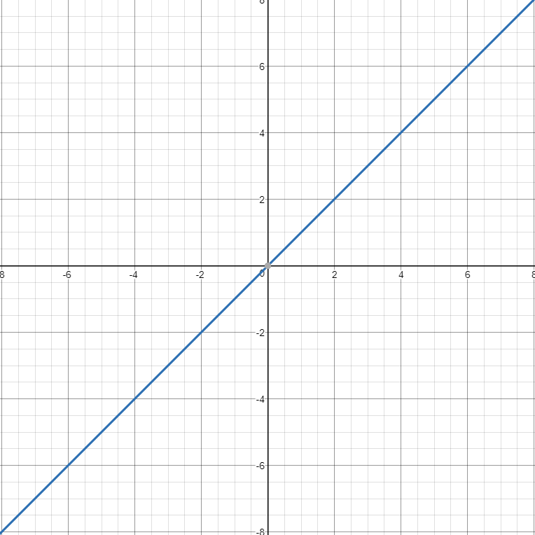
$$Linear Family$$

Slide 84
$$f\left(x\right)=x^{2},x^{4},x^{6}…$$

Slide 85
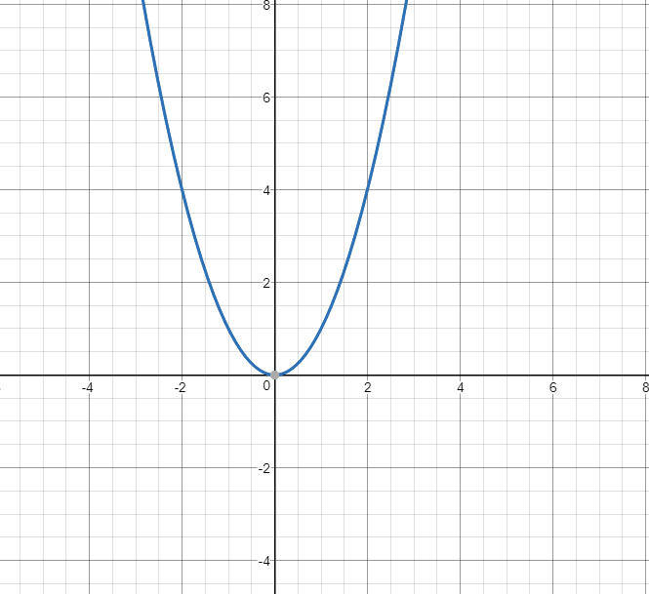
$$Parabolic Family$$

Slide 86
$$f\left(x\right)=x^{3},x^{5},x^{7}…$$

Slide 87
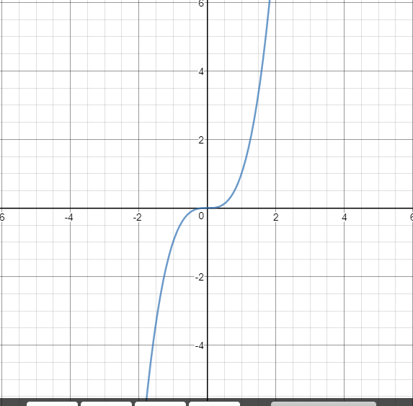
$$Cubic Family$$

Slide 88
$$f\left(x\right)=x^{1/2},x^{1/4},x^{1/6}…$$

Slide 89
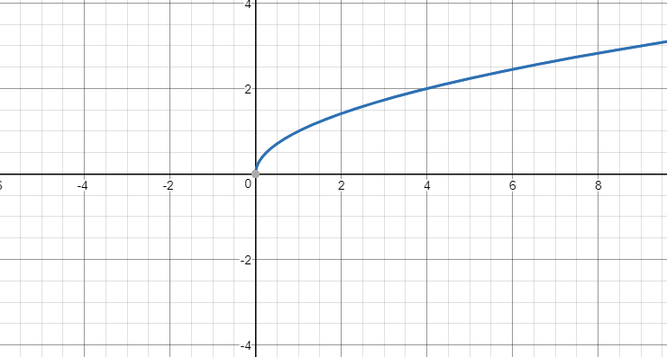
$$Square Root Family$$

Slide 90
$$f\left(x\right)=x^{1/3},x^{1/5},x^{1/7}…$$

Slide 91
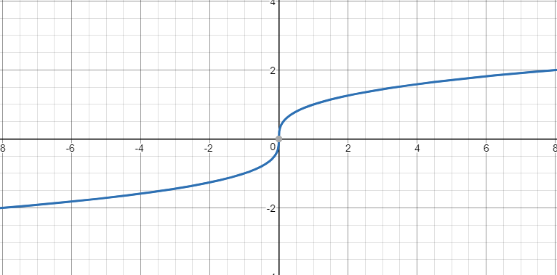
$$Cubic Root Family$$

Slide 92
$$f\left(x\right)=x^{−1},x^{−3},x^{−5}…$$

Slide 93
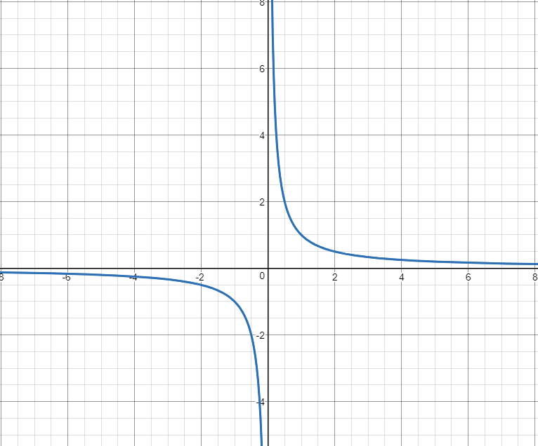
$$Rational Function$$

Slide 94
$$f\left(x\right)=x^{−2},x^{−4},x^{−6}…$$

Slide 95
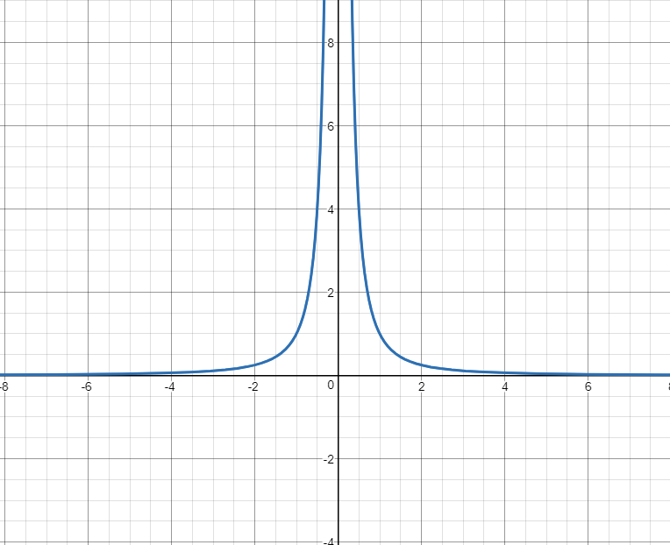
$$Bell Curve Family$$

Slide 96
$$f\left(x\right)=x^{2/3},x^{4/5},x^{6/7}…$$

Slide 97
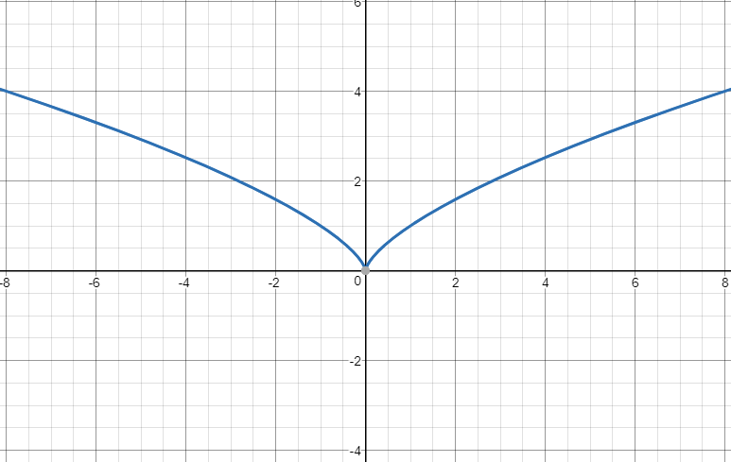
$$Bird Family$$

Slide 98
$$f\left(x\right)=\left[\left|x\right|\right]$$

Slide 99
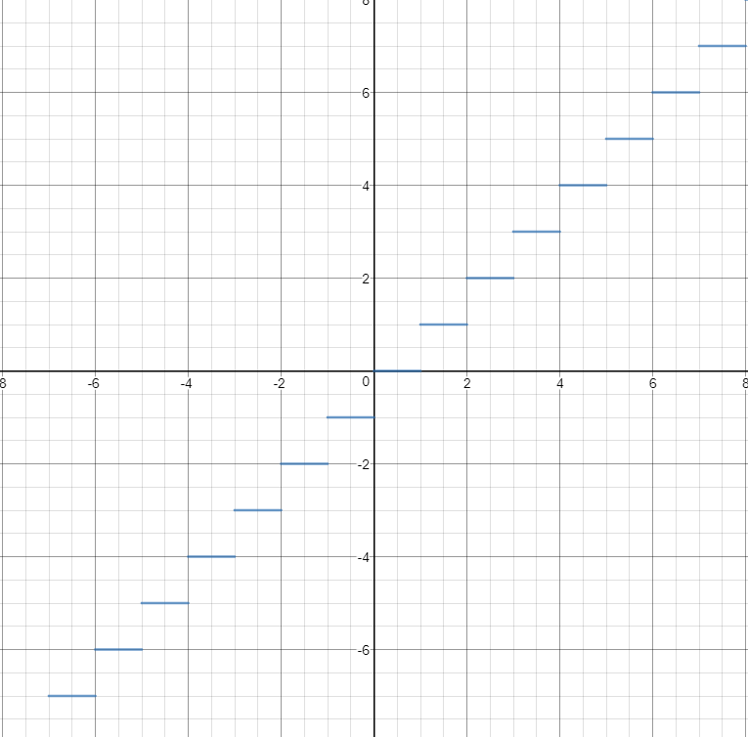
$$Greatest integer function$$

Slide 100
$$f\left(x\right)=\left|x\right|$$

Slide 101
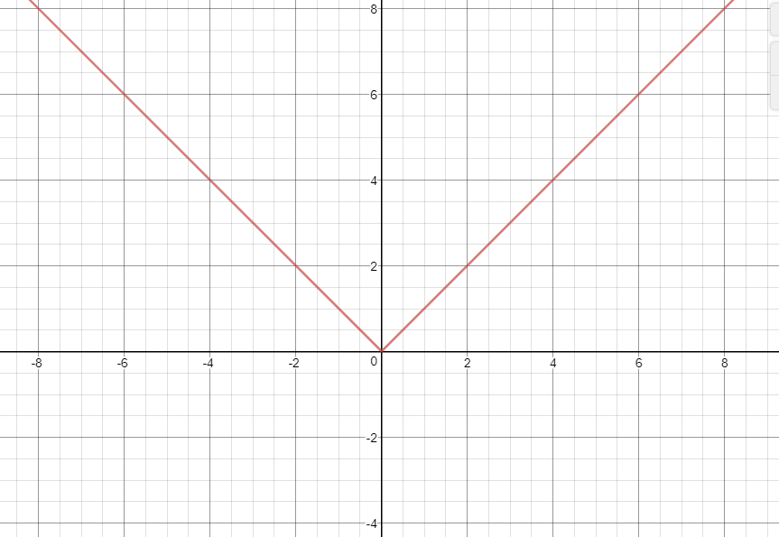
$$Absolute Value$$

Slide 102
$$f\left(x\right)=ax^{2}+bx+c$$

Slide 103
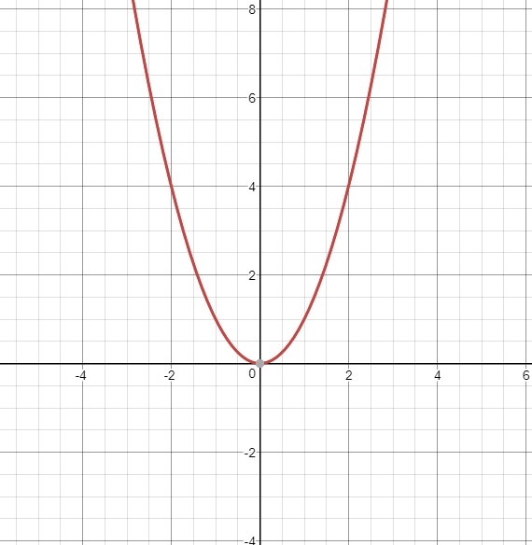
$$Parabola Family$$

Slide 104
$$f\left(x\right)=ax^{2}+bx+c$$
$$Vertex?$$

Slide 105
$$Vertex →\left(h, k\right)$$
$$h={−b}/{2a}$$
$$k=f({−b}/{2a})$$

Slide 106
$$f\left(x\right)=a_{n}x^{n}+a_{n−1}x^{n−1}+…+a_{0}$$
$$n is even$$

Slide 107
$$1) end behavior→parabolic$$
$$2) intercepts$$
$$3) relative extrema \left(n−1\right)$$
$$4)symmetry$$

Slide 108
$$f\left(x\right)=a_{n}x^{n}+a_{n−1}x^{n−1}+…+a_{0}$$
$$n is odd$$

Slide 109
$$1) outside behavior→cubic$$
$$2) intercepts$$
$$3) relative extrema \left(n−1\right)$$
$$4)symmetry$$

Slide 110
$$f\left(x\right)=\frac{a_{n}x^{n}+a_{n−1}x^{n−1}+…+a_{0}}{b_{m}x^{m}+b_{m−1}x^{m−1}+…+b_{0}}$$

Slide 111
$$1) asymptotes$$
$$2) intercepts$$
$$3) symmetry$$
$$4) plot points, if needed$$

Slide 112
$$To find vertical asymptotes…$$

Slide 113
$$Set denominator of$$
$$simplified rational$$
$$expression equal to 0$$

Slide 114
$$To find horizontal asymptotes$$
$$of rational functions…$$

Slide 115
$$n=m, horiz. asym @ y= a/b$$
$$n<m, horiz. asym @ y=0$$
$$n>m, no horiz. asym$$

Slide 116
$$f\left(x\right)=\sqrt{c−x^{2}}, c>0$$

Slide 117
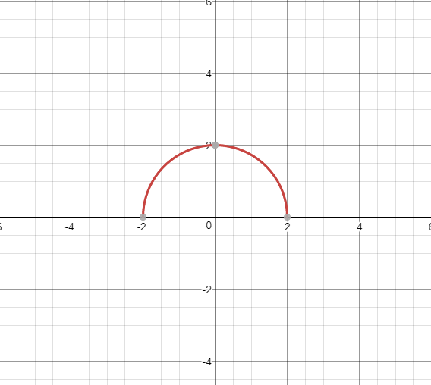
$$Circular function$$

Slide 118
$$f\left(x\right)=\sqrt{x^{2}−c}, c>0$$

Slide 119
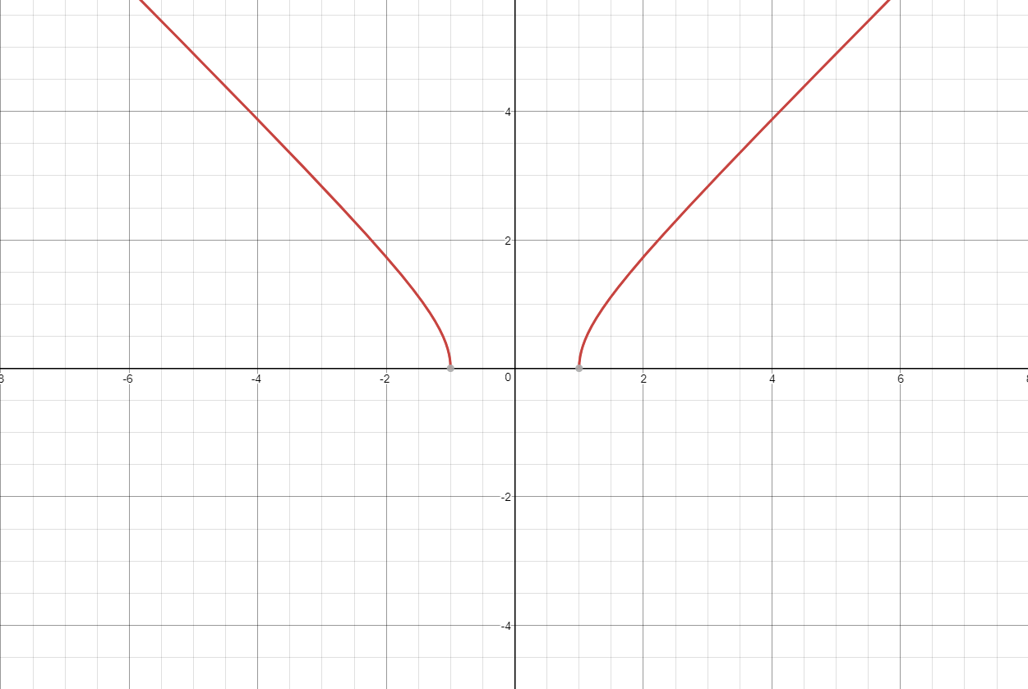
$$Hyperbolic function$$

Slide 120
$$f\left(x\right)=\sqrt{x^{2}+c}$$

Slide 121
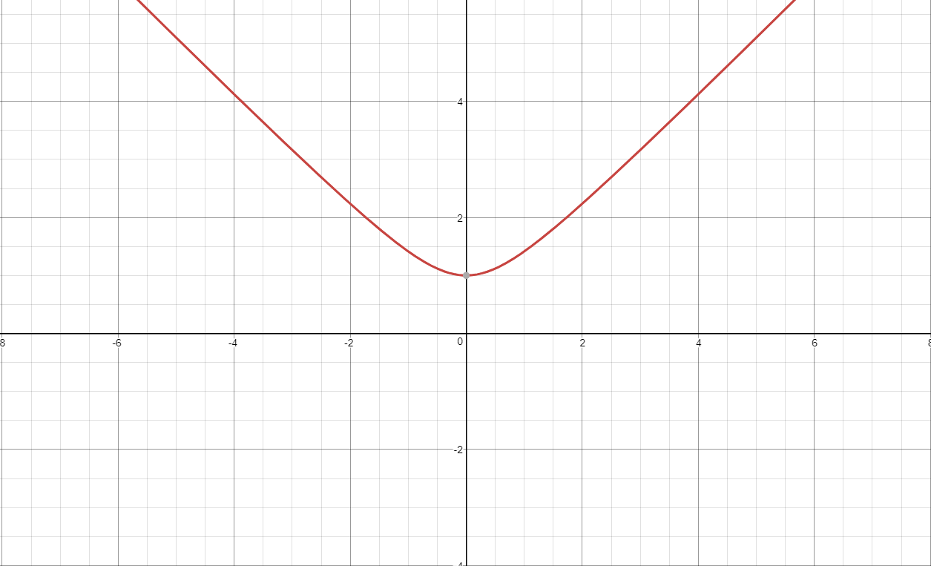
$$Hyperbolic function$$

Slide 122
Trigonometric
Functions

Slide 123
$$Law of Sines$$

Slide 124
$$\frac{a}{sin A}=\frac{b}{sin B}=\frac{c}{sin C}$$

Slide 125
$$Law of Cosines$$

Slide 126
$$a^{2}=b^{2}+c^{2}−2bc∙CosA$$
$$b^{2}=a^{2}+c^{2}−2ac∙CosA$$
$$c^{2}=a^{2}+b^{2}−2ab∙CosA$$

Slide 127
$$Law of Sines is used for…$$

Slide 128
$$AAS, ASA, SSA$$

Slide 129
$$Law of Cosines is used for…$$

Slide 130
$$SSS, SAS$$

Slide 131
$$Area of a triangle$$
(SAS)

Slide 132
$$A=\frac{1}{2}ab∙SinC$$
$$A=\frac{1}{2}bc∙SinA$$
$$A=\frac{1}{2}ac∙SinB$$

Slide 133
$$Area of a Circle Sector$$

Slide 134
$$A=\frac{1}{2}r^{2}θ$$

Slide 135
$$Arc Length of a circle$$

Slide 136
$$S=rθ$$

Slide 137
Signs of Trig Ratios

Slide 138
Students
All
Take
Calculus

Slide 139
$$Graph of sin x$$

Slide 140
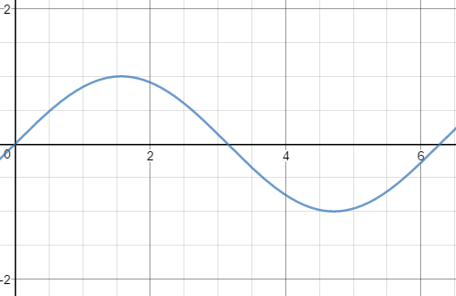

Slide 141
$$Graph of cos x$$

Slide 142
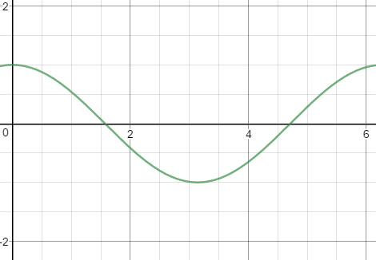

Slide 143
$$Graph of tan x$$

Slide 144
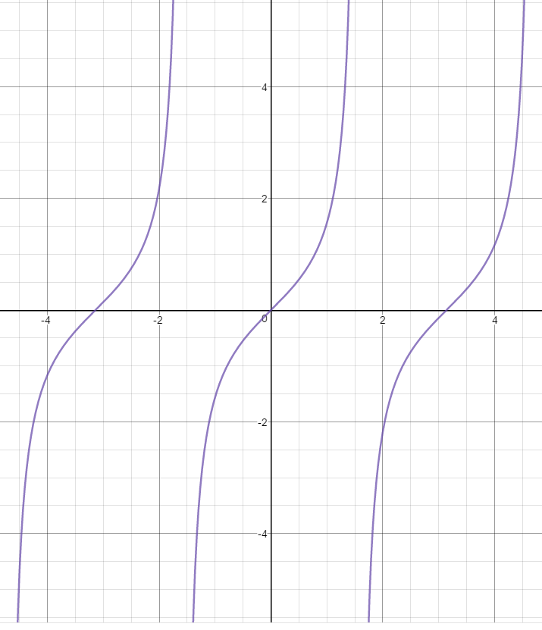

Slide 145
$$Graph of csc x$$

Slide 146
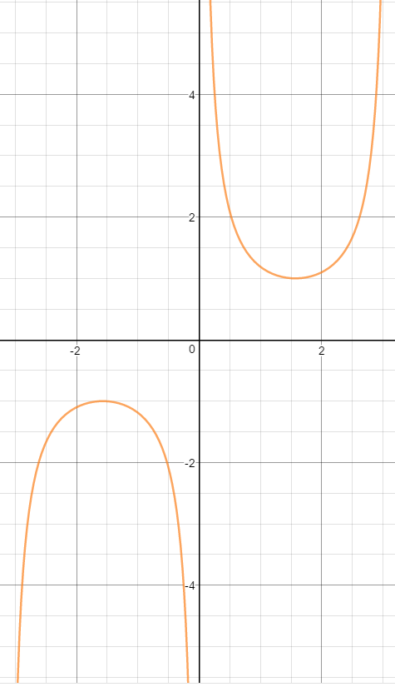

Slide 147
$$Graph of sec x$$

Slide 148
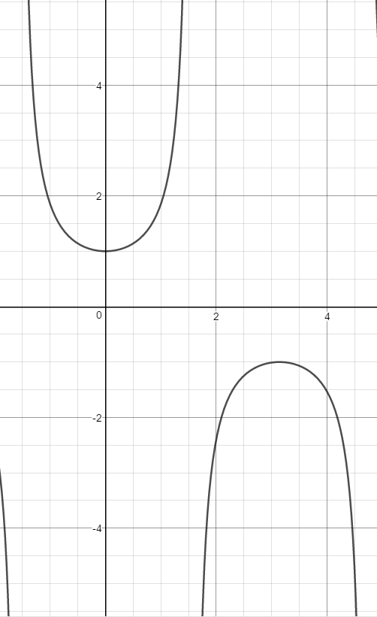

Slide 149
$$Graph of cot x$$

Slide 150
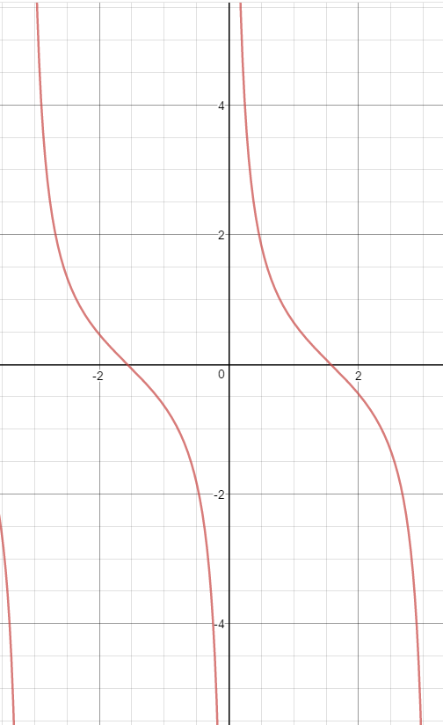

Slide 151
$$Period of sin x, cos x,$$
$$sec x \& csc x$$

Slide 152
$$2π$$

Slide 153
$$Period of tan x \& cot x$$

Slide 154
$$π$$

Slide 155
$$Amplitude of Trig Functions$$

Slide 156
$$sin x →1$$
$$cos x→1$$
$$tan x →None or NA$$
$$csc x→1$$
$$sec x→1$$
$$cot x→None or NA$$

Slide 157
$$f\left(x\right)=a∙sin b\left(x−c\right)+d$$

Slide 158
$$a=amplitude$$
$$b→\frac{2π}{b}or\frac{π}{b}is period$$
$$c=Phase shift (Horiz)$$
$$d=Vertical Shift$$

Slide 159
$$Graph of \sqrt{x}∙sin x$$

Slide 161
$$Graph of e^{x}∙sin x$$

Slide 162
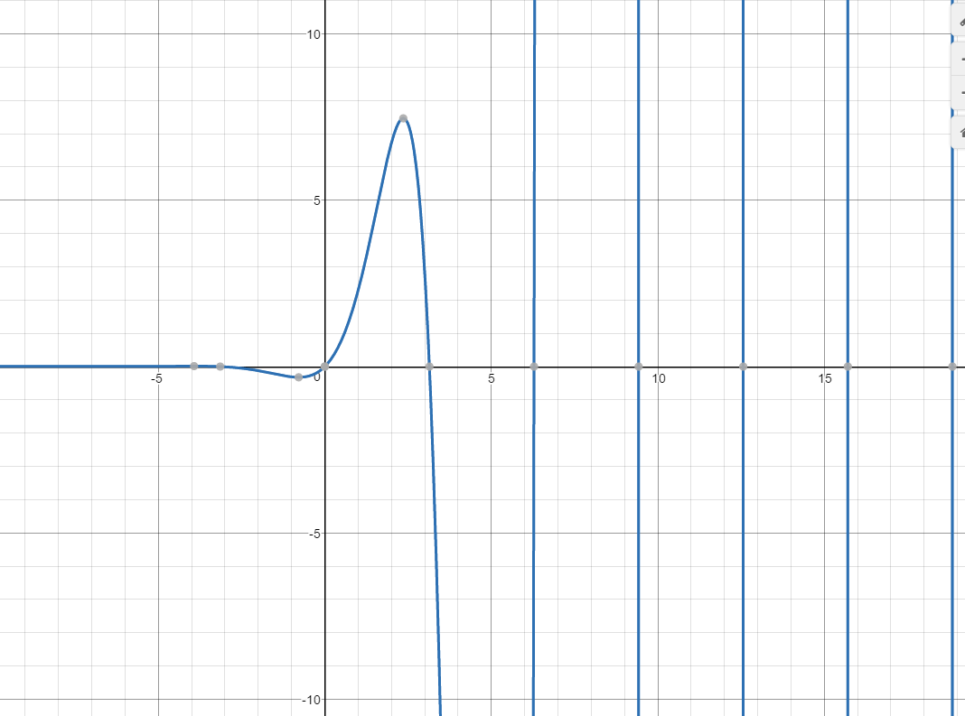

Slide 163
$$Graph of x∙sin x$$

Slide 164
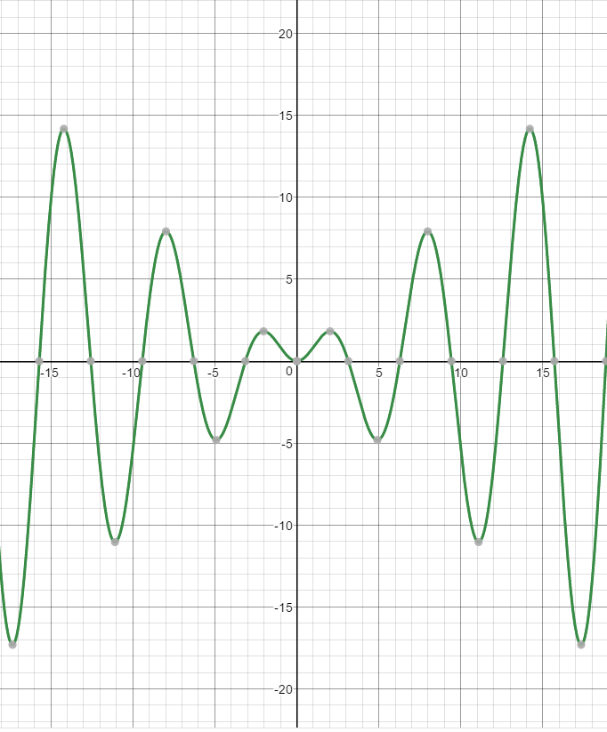

Slide 165
$$Graph of 1+sin x$$

Slide 166
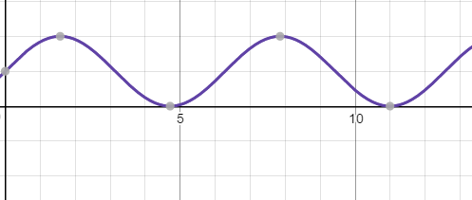

Slide 167
$$Graph of x+sin x$$

Slide 168
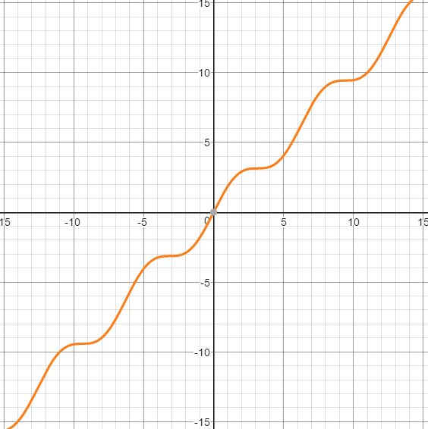

Slide 169
$$Graph of \sqrt{x}+sin x$$

Slide 170
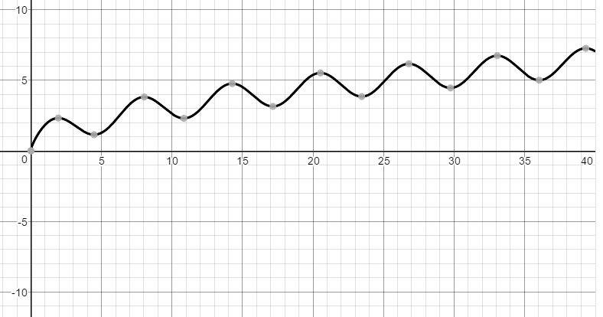

Slide 171
$$Fundamental Identities$$

Slide 172
$$tan x=\frac{sin x}{cos x}$$
$$cot x=\frac{cos x}{sin x}$$

Slide 173
$$Pythagorean Identities$$

Slide 174
$$\sin^{2}x+\cos^{2}x=1$$
$$1+\cot^{2}x=\csc^{2}x$$
$$\tan^{2}x+1=\sec^{2}x$$

Slide 175
$$\sin^{2}x+\cos^{2}x=1$$
$$Two other forms$$

Slide 176
$$1−\sin^{2}x=\cos^{2}x$$
$$1−\cos^{2}x=\sin^{2}x$$

Slide 177
$$Reciprocal Identities$$

Slide 178
$$csc x=\frac{1}{sin x}$$
$$sec x=\frac{1}{cos x}$$
$$cot x=\frac{1}{tan x}$$

Slide 179
$$Cofunction Identities$$

Slide 180
$$sin (\frac{1}{2}π−x)=cos x$$
$$cos (\frac{1}{2}π−x)=sin x$$
$$tan (\frac{1}{2}π−x)=cot x$$

Slide 181
$$Power Identities$$

Slide 182
$$\sin^{2} x=\frac{1−cos 2x}{2}$$
$$\cos^{2} x=\frac{1+cos 2x}{2}$$

Slide 183
$$Double Angle Identities$$

Slide 184
$$sin 2x=2 sinx cosx$$
$$cos 2x=\sin^{2}x−\cos^{2}x$$

Slide 185
$$Sum \& Difference Identities$$

Slide 186
$$sin \left(x+y\right)= sin x cos y+cos x sin y$$
$$sin \left(x−y\right)= sin x cos y−cos x sin y$$
$$cos \left(x+y\right)= cos x cos y−sin x sin y$$
$$cos \left(x−y\right)= cos x cos y+sin x sin y$$

Slide 187
Conics

Slide 188
$$Standard Form of a Conic$$

Slide 189
$$Ax^{2}+By^{2}+Cx+Dy+E+0$$
A & B cannot both = 0

Slide 190
$$PARABOLA$$
$$y=a{\left(x−h\right)}^{2}+k$$
Focus = ???
Directrix = ???

Slide 191
Focus--->$\left(h, k+ \frac{1}{4a}\right)$
Directrix--->$y=k−\frac{1}{4a}$

Slide 192
$$Intercept form of a circle$$

Slide 193
$$\frac{{(x−h)}^{2}}{a^{2}}+\frac{{(y−k)}^{2}}{b^{2}}=1$$
when a = b
OR
$${(x−h)}^{2}+{(y−k)}^{2}=r^{2}$$

Slide 194
$$Intercept form of a ellipse$$

Slide 195
$$\frac{{(x−h)}^{2}}{a^{2}}+\frac{{(y−k)}^{2}}{b^{2}}=1$$
$$\frac{{(x−h)}^{2}}{b^{2}}+\frac{{(y−k)}^{2}}{a^{2}}=1$$
where a > b

Slide 196
$$Intercept form$$
$$of a hyperbola$$

Slide 197
$$\frac{{(x−h)}^{2}}{a^{2}}−\frac{{(y−k)}^{2}}{b^{2}}=1$$
$$\frac{{(y−k)}^{2}}{a^{2}}−\frac{{(x−h)}^{2}}{b^{2}}=1$$

Slide 198
$$In a Conic section,$$
$$c= ?$$

Slide 199
$$The distance from the center$$
$$to the focus/foci$$

Slide 200
To find the foci…

Slide 201
$$ELLIPSE$$
$$c^{2}=a^{2}−b^{2}$$
$$HYPERBOLA$$
$$c^{2}=a^{2}+b^{2}$$

Slide 202
To find the asymptotes for a hyperbola…

Slide 203
$$(y−k)=±\frac{b}{a}(x−h)$$

Slide 204
$$\frac{{(x−h)}^{2}}{a^{2}}+\frac{{(y−k)}^{2}}{b^{2}}=0$$
Is the graph of….

Slide 205
Point (h, k)

Slide 206
$$\frac{{(x−h)}^{2}}{a^{2}}+\frac{{(y−k)}^{2}}{b^{2}}=−C$$
Is the graph of….

Slide 207
$$∅$$
The empty set

Slide 208
$$\frac{{(x−h)}^{2}}{a^{2}}−\frac{{(y−k)}^{2}}{b^{2}}=0$$
Is the graph of….

Slide 209
Two lines (asymptotes)

Slide 210
$$\frac{{(x−h)}^{2}}{a^{2}}−\frac{{\left(y−k\right)}^{2}}{b^{2}}=−C$$
Is the graph of….

Slide 211
A hyperbola (still!!!)

Slide 212
Logarithmic
&
Exponential
Functions

Slide 213
$$a^{x}$$
X is a positive integer

Slide 214
$$=a∗a∗a…. (x times)$$

Slide 215
$$a^{−x}$$
X is a positive integer

Slide 216
$$\frac{1}{a^{x}}$$

Slide 217
$$a^{x}∗a^{y}$$

Slide 218
$$a^{x+y}$$

Slide 219
$$\frac{a^{x}}{a^{y}}$$

Slide 220
$$a^{x−y}$$

Slide 221
$$({a^{x})}^{y}$$

Slide 222
$$a^{xy}$$

Slide 223
$$a^{0}$$

Slide 224
$$1$$

Slide 225
$$a^{x/y}$$

Slide 226
X is the power, y is the root

Slide 227
Radical form for…
$$a^{m/n}$$

Slide 228
$\sqrt[n]{a^{m}}$ or ${(\sqrt[n]{a})}^{m}$

Slide 229
${\sqrt[n]{x}}^{n}$ , where n is even

Slide 230
$$\left|x\right|$$

Slide 231
e =
(2 diff expressions)

Slide 232
${\left(1+\frac{1}{x}\right)}^{x}$as $x→∞$
or
${\left(1+x\right)}^{1/x}$ as $x→0$

Slide 233
e is approximately…

Slide 234
2.718…

Slide 235
$$f\left(x\right)=b^{x}, b>1$$

Slide 236
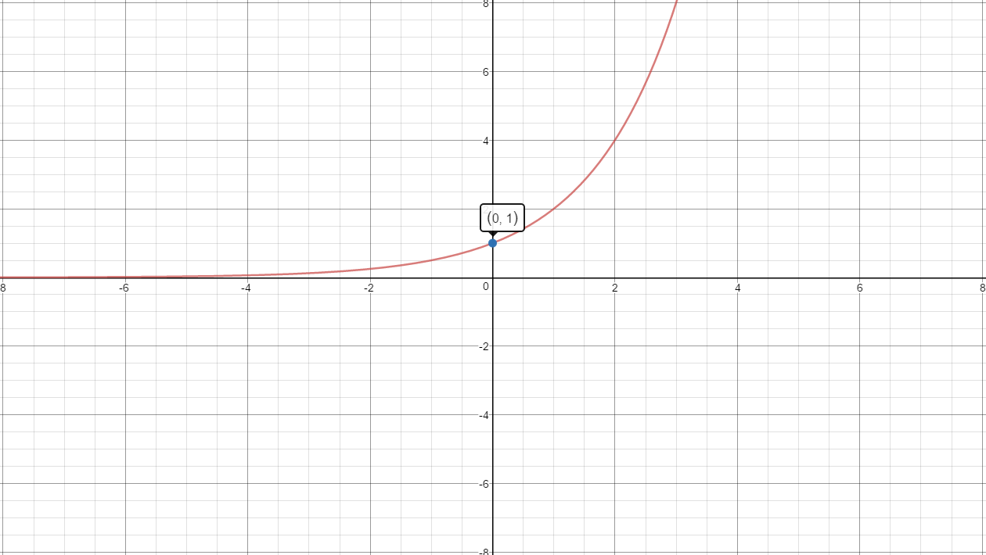

Slide 237
$$f\left(x\right)=b^{x}, 0<b<1$$

Slide 238
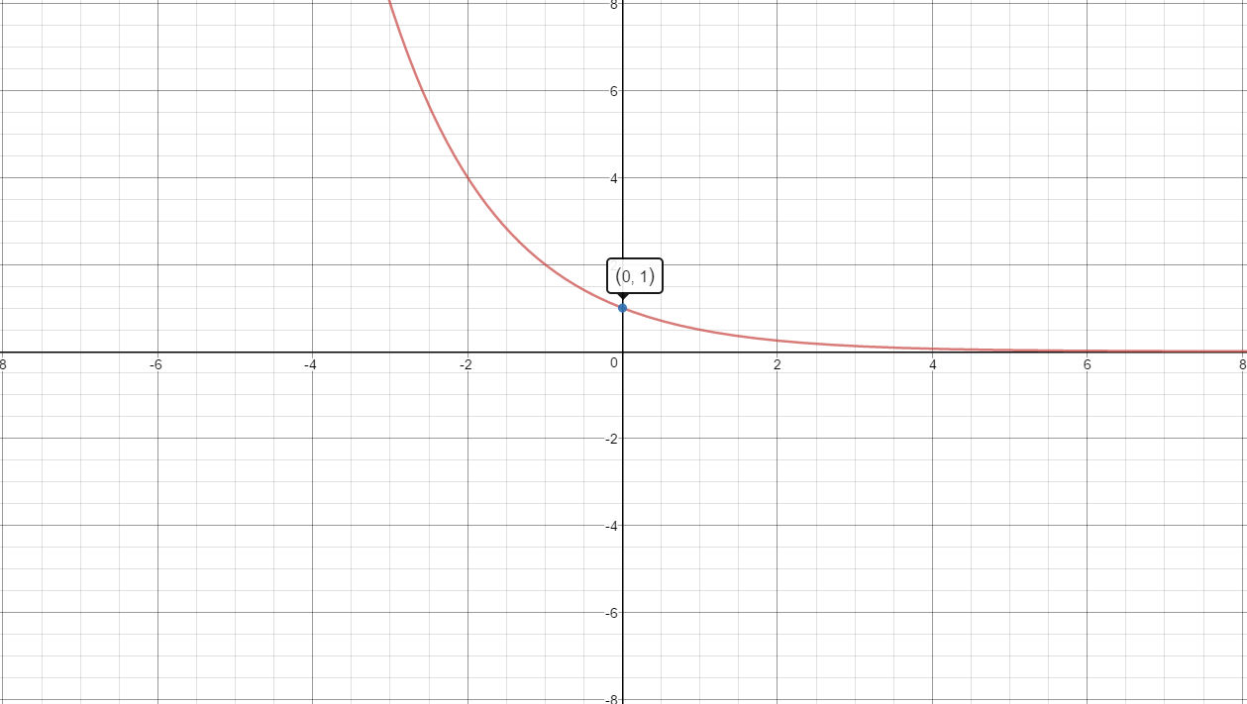

Slide 239
$$f\left(x\right)=e^{x}$$

Slide 241
$$\log_{a}(xy)$$

Slide 242
$$\log_{a}\left(x\right)+\log_{a}(y)$$

Slide 243
$$\log_{a}\left(\frac{x}{y}\right)$$

Slide 244
$$\log_{a}\left(x\right)−\log_{a}(y)$$

Slide 245
$$\log_{a}\left(x^{y}\right)$$

Slide 246
$$y∗\log_{a}\left(x\right)$$

Slide 247
Change of Base Formula
$$\log_{b}\left(a\right)$$

Slide 248
$$\frac{log a}{log b}=\frac{ln a}{ln b}$$

Slide 249
$$ln(1)$$

Slide 250
$$0$$

Slide 251
$$ln(e)$$

Slide 252
$$1$$

Slide 253
$$f\left(x\right)=\log_{b}(x), b>1$$

Slide 254
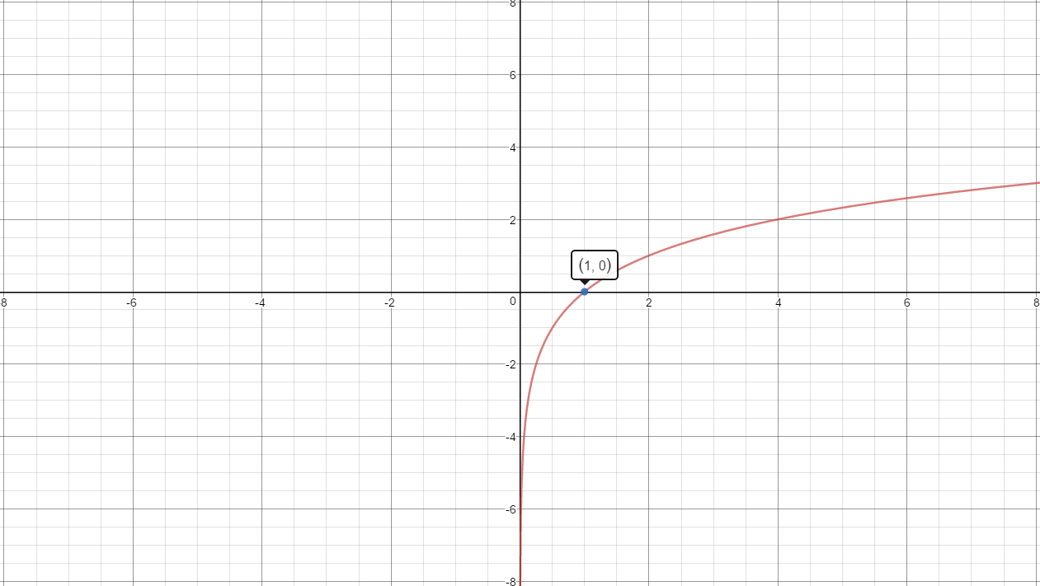

Slide 255
$$f\left(x\right)=\log_{b}\left(x\right), 0<b<1$$

Slide 256
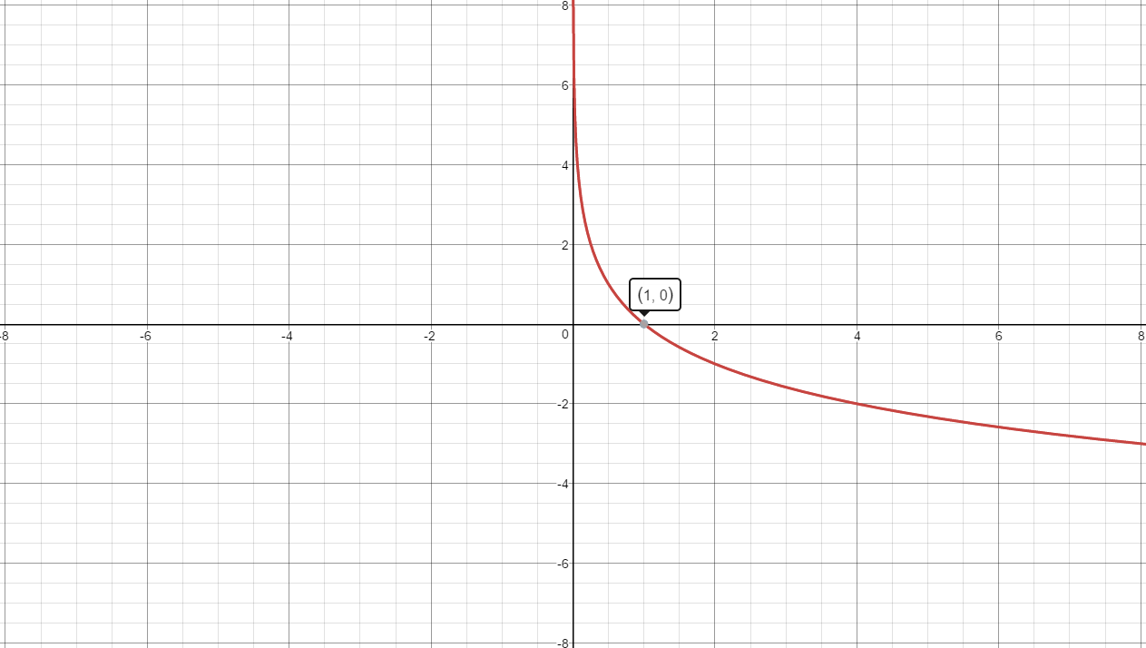

Slide 257
$$f\left(x\right)=ln x$$

Slide 259
$$Investment equation$$
Simple interest
A=

Slide 260
$$A=P\left(1+rt\right)$$
P=principle
r = interest rate (decimal)
t = # of years

Slide 261
$$Investment equation$$
Compound interest
A=

Slide 262
$$A=P{\left(1+\frac{r}{n}\right)}^{nt}$$
P=principle
r = interest rate (decimal)
t = # of years

Slide 263
$$Investment equation$$
Continuous interest
A=

Slide 264
$$A=P{\left(e\right)}^{rt}$$
P=principle
r = interest rate (decimal)
t = # of years

Slide 265
$$Population Growth$$
y =

Slide 266
$$y=B{\left(e\right)}^{kt}, k>0$$

Slide 267
$$Radioactive Decay$$
y =

Slide 268
$$y=B{\left(e\right)}^{kt}, k<0$$

Slide 269
$$Population Growth$$
Model

Slide 270
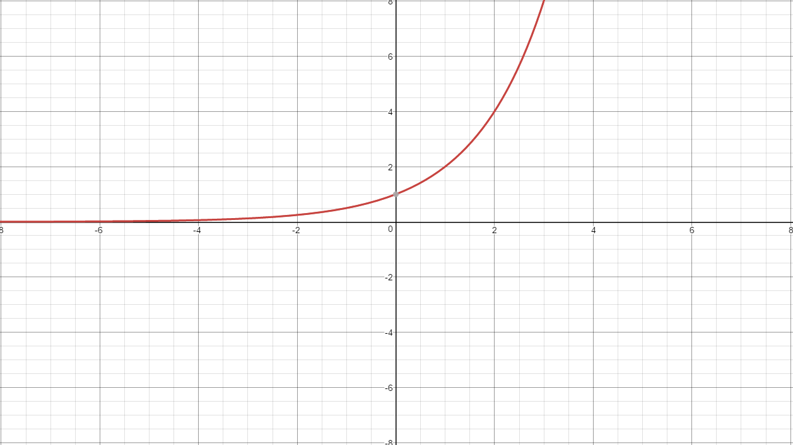

Slide 271
$$Radioactive Decay$$
Model

Slide 272
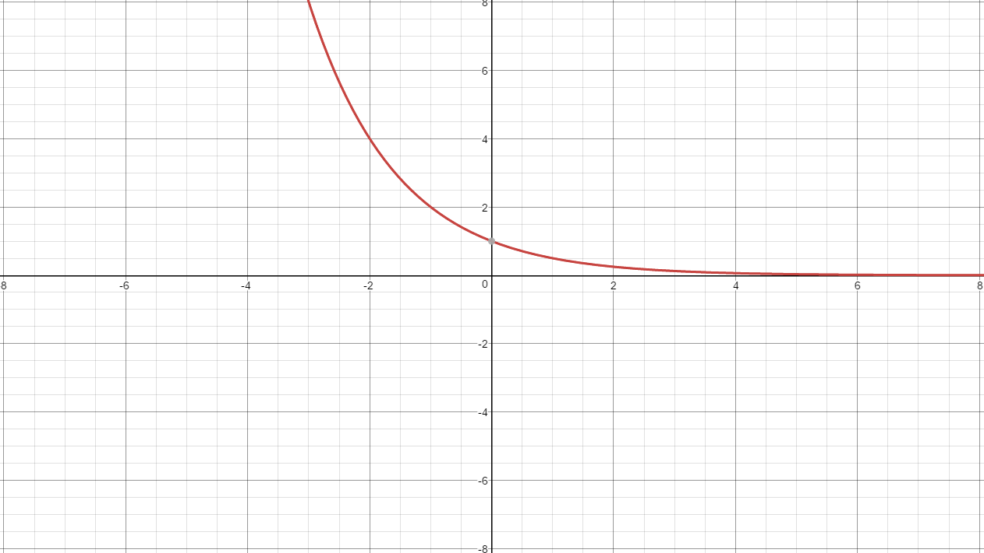

Slide 273
$$Bounded Growth$$
y =

Slide 274
$$y=A−B{\left(e\right)}^{−kt}, t≥0$$

Slide 275
$$Logistic Growth$$
y =

Slide 276
$$y=\frac{A}{1+Be^{−Akt}} t≥0$$

Slide 277
$$Bounded Growth$$
Graph

Slide 278
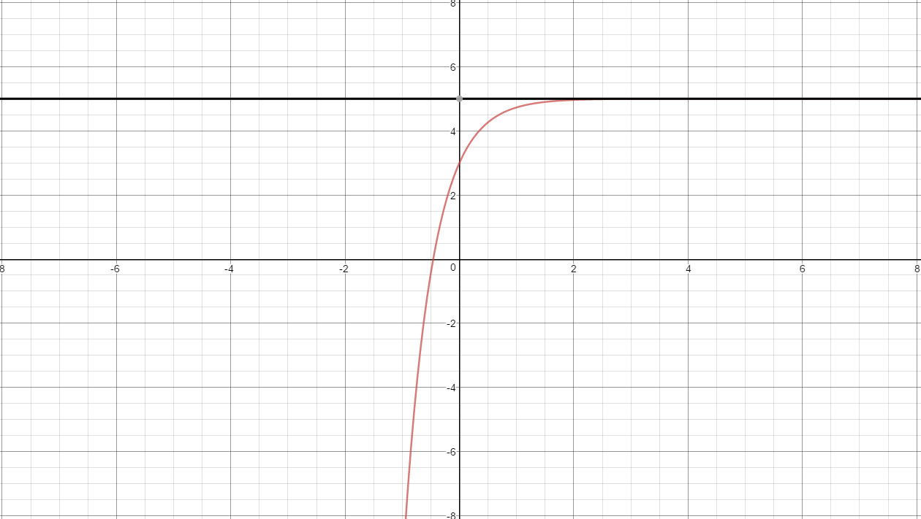
A
A-B

Slide 279
$$Logistic Growth$$
Graph

Slide 280
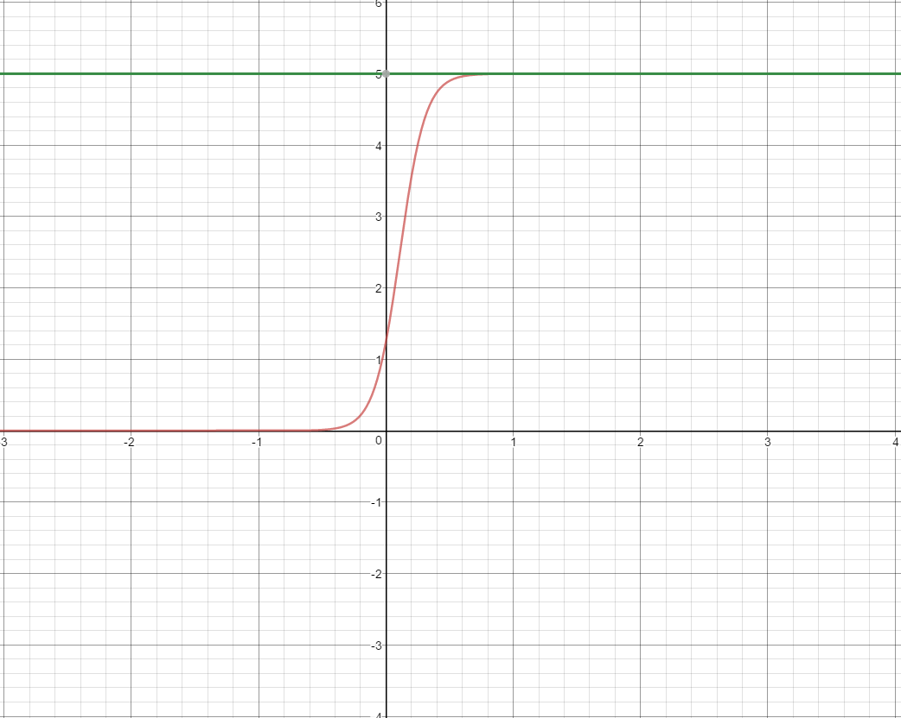
A
A/(1+B)

Slide 281
Sequence & Series

Slide 282
$$sequence$$

Slide 283
$$a set of numbers that share$$
$$a common property and$$
$$whose domain is the set of$$
$$all positive integers$$

Slide 284
$$convergent sequence$$

Slide 285
$$a sequence that has a limit$$
$$as n→∞$$

Slide 286
$$divergent sequence$$

Slide 287
$$a sequence that is$$
$$not convergent$$

Slide 288
$$General Arithmetic series$$

Slide 289
$$a_{1}+\left(a_{1}+d\right)+…+$$
$$(a_{1}+\left(n−1\right)d)$$

Slide 290
$$Sum of an Arithmetic series$$

Slide 291
$$S_{n}=\frac{n}{2}(a_{1}+a_{n})$$

Slide 292
$$General Geometic series$$

Slide 293
$$a_{1}+\left(a_{1}r\right)+\left(a_{1}r^{2}\right)+…+$$
$$(a_{1}r^{n−1})$$

Slide 294
$$Sum of an Geometic series$$

Slide 295
$$S_{n}=\frac{a_{1}(1−r^{n})}{1−r}$$

Slide 296
$$Pascal^{′}s Triangle$$

Slide 297
1
1
1 2 1
1 3 3 1
1 4 6 4 1
1 5 10 10 5 1

Slide 298
$$Binomial Coefficient$$
$$\left(\begin{matrix}n \\ r\end{matrix}\right)$$

Slide 299
Combination of $\text{"}\text{n}\text{" }\text{things} \text{chosen}\text{ "}\text{r}\text{" }\text{at} \text{a} \text{time}$

Slide 300
$$Binomial Theorem$$
${(a+b)}^{n}$

Slide 301
$$\left(\begin{matrix}n \\ 0\end{matrix}\right)a^{n}+\left(\begin{matrix}n \\ 1\end{matrix}\right)a^{n−1}b^{1}+\left(\begin{matrix}n \\ 2\end{matrix}\right)a^{n−2}b^{2}$$
$$+…+\left(\begin{matrix}n \\ n\end{matrix}\right)b^{n}$$

Slide 302
Polars

Slide 303
$$To convert from$$
$$rectangular to polar$$
$$(3 ways)$$

Slide 304
$$1) x=r∗cosθ$$
$$2) y=r∗sinθ$$
$$3) x^{2}+y^{2}=r^{2}$$

Slide 305
$$Important characteristics$$
$$of points in$$
$$polar coordinates$$

Slide 306
$$Each ordered pair$$
$$is not unique$$

Slide 307
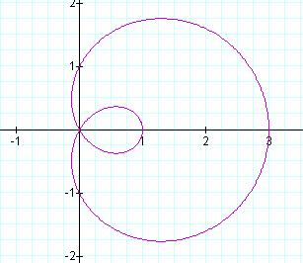
$$name of graph?$$

Slide 308
$$limacon with inner loop$$

Slide 309
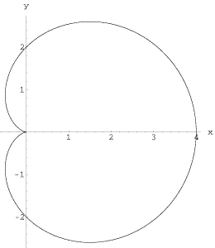
$$name of graph?$$

Slide 310
$$cardioid$$

Slide 311
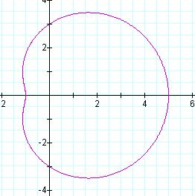
$$name of graph?$$

Slide 312
$$limacon with dent/dimple$$

Slide 313
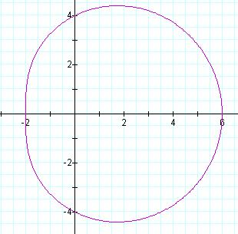
$$name of graph?$$

Slide 314
$$convex limacon$$

Slide 315
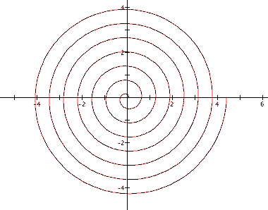
$$name of graph?$$

Slide 316
$$spiral$$

Slide 317
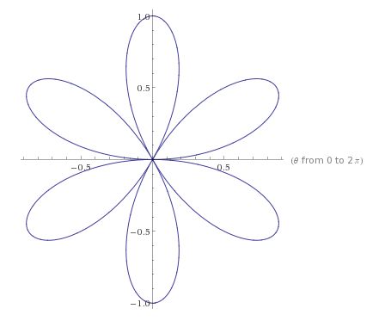
$$name of graph?$$

Slide 318
$$petal curve$$

Slide 319
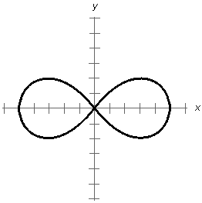
$$name of graph?$$

Slide 320
$$lemniscate$$

Slide 321
$$r=\frac{c}{cosθ}$$

Slide 322
$$vertical line$$

Slide 323
$$r=\frac{c}{sinθ}$$

Slide 324
$$horizontal line$$

Slide 325
$$θ=c$$

Slide 326
$$a line that makes an angle$$
$$of c radians with$$
$$the polar axis$$

Slide 327
$$r=c$$

Slide 328
$$a circle with center (0,0)$$
$$radius=c$$

Slide 329
$$r=2acosθ+2bsinθ$$

Slide 330
$$circle with center \left(a,b\right)$$
$$radius= \sqrt{a^{2}+b^{2}}$$

Slide 331
$$r=θ$$

Slide 332
$$spiral$$

Slide 333
$$r=a±bsinθ$$
$r=a±bcosθ$

Slide 334
$$limacon/cardiod$$

Slide 335
$$r=a+bsinθ$$
$$points?$$

Slide 336
$$Points up$$

Slide 337
$$r=a−bsinθ$$
$$points?$$

Slide 338
$$Points down$$

Slide 339
$$r=a+bcosθ$$
$$points?$$

Slide 340
$$Points right$$

Slide 341
$$r=a−bcosθ$$
$$points?$$

Slide 342
$$Points left$$

Slide 343
$$r=a±bsinθ$$
$$r=a±bcosθ$$
$$0<\left|a/b\right|<1$$

Slide 344
$$limacon with a loop$$

Slide 345
$$r=a±bsinθ$$
$$r=a±bcosθ$$
$$\left|a/b\right|=1$$

Slide 346
$$cardioid$$

Slide 347
$$r=a±bsinθ$$
$$r=a±bcosθ$$
$$1<\left|a/b\right|<2$$

Slide 348
$$limacon with a dent/dimple$$

Slide 349
$$r=a±bsinθ$$
$$r=a±bcosθ$$
$$\left|a/b\right|>2$$

Slide 350
$$convex limacon$$

Slide 351
$$extreme values of a$$
$$limacon/cardioid$$

Slide 352
$$\left|a\right|+\left|b\right|$$
$$\left|b\right|−\left|a\right|$$

Slide 353
$$r=acos(nθ)$$
$n is odd$

Slide 354
$$petal curve with n petals$$

Slide 355
$$r=asin(nθ)$$
$n is odd$

Slide 356
$$petal curve with n petals$$

Slide 357
$$r=acos(nθ)$$
$n is even$

Slide 358
$$petal curve with 2n petals$$

Slide 359
$$r=asin(nθ)$$
$n is even$

Slide 360
$$petal curve with 2n petals$$

Slide 361
$$r=asin\left(nθ\right)$$
$$r=acos(nθ)$$
$a=?$

Slide 362
$$length of each petal$$

Slide 363
$$r^{2}=acos(2θ)$$
$$r^{2}=asin(2θ)$$

Slide 364
$$lemniscate$$

Slide 365
$$r^{2}=acos(2θ)$$
$$r^{2}=asin\left(2θ\right)$$
$$a= ?$$

Slide 366
$$\sqrt{a} =length of each petal$$

Slide 367
Vectors

Slide 368
$$Magnitude of a vector<a_{1}, a_{2}>$$
$$\left\|A\right\|=$$

Slide 369
$$=\sqrt{{(a_{1})}^{2}+{(a_{2})}^{2}}$$

Slide 370
$$Direction angle of a vector<a_{1}, a_{2}>$$
$$θ=$$

Slide 371
$$tanθ=\frac{a_{2}}{a_{1}}$$

Slide 372
$$The sum of two vectors is…$$

Slide 373
$$The sum of the$$
$$corresponding components$$

Slide 374
$$The difference of two$$
$$vectors is…$$

Slide 375
$$The difference of the$$
$$corresponding components$$

Slide 376
$$Scalar Multiplication$$
$$if c is a scalar and A is$$
$$the vector<a_{1}, a_{2}>$$
$then c∗A=$

Slide 377
$$<{c∗a}_{1}, c∗a_{2}>$$

Slide 378
$$\overset{⃑}{i}$$

Slide 379
$$<1, 0>$$

Slide 380
$$\overset{⃑}{j}$$

Slide 381
$$<0, 1>$$

Slide 382
$<a,b>$
$$in terms of the unit vectors$$

Slide 383
$$ai+bj$$

Slide 384
$$Vector \overset{⃑}{AB}$$
$$in standard position$$
$$A<a_{1},a_{2}>, B<b_{1}, b_{2}>$$

Slide 385
$$<b_{1}−a_{1}, b_{2}−a_{2}>$$

Slide 386
$$e_{\overset{⃑}{v}}$$
$$Unit vector in direction of \overset{⃑}{v}$$

Slide 387
$$\left\langle \frac{v_{1}}{\left\|v\right\|}, \frac{v_{2}}{\left\|v\right\|}\right\rangle$$

